Slide 1


Slide 2
Password Attacks
Used against authentication systems
Resources and limitations
Processing power
Storage
Network bandwidth
Notes:
Mention Plaintext and Unencrypted vs. for example OS password files that are encrypted

Slide 3
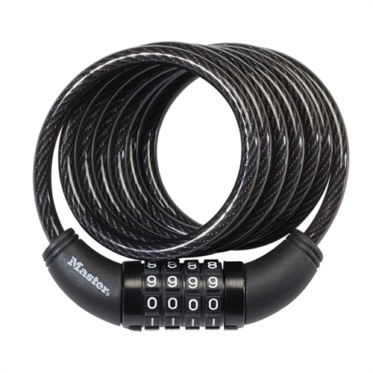
Brute Force Attack
Guessing attack
Every possible combination
0000
0001
0002
0003

Slide 4
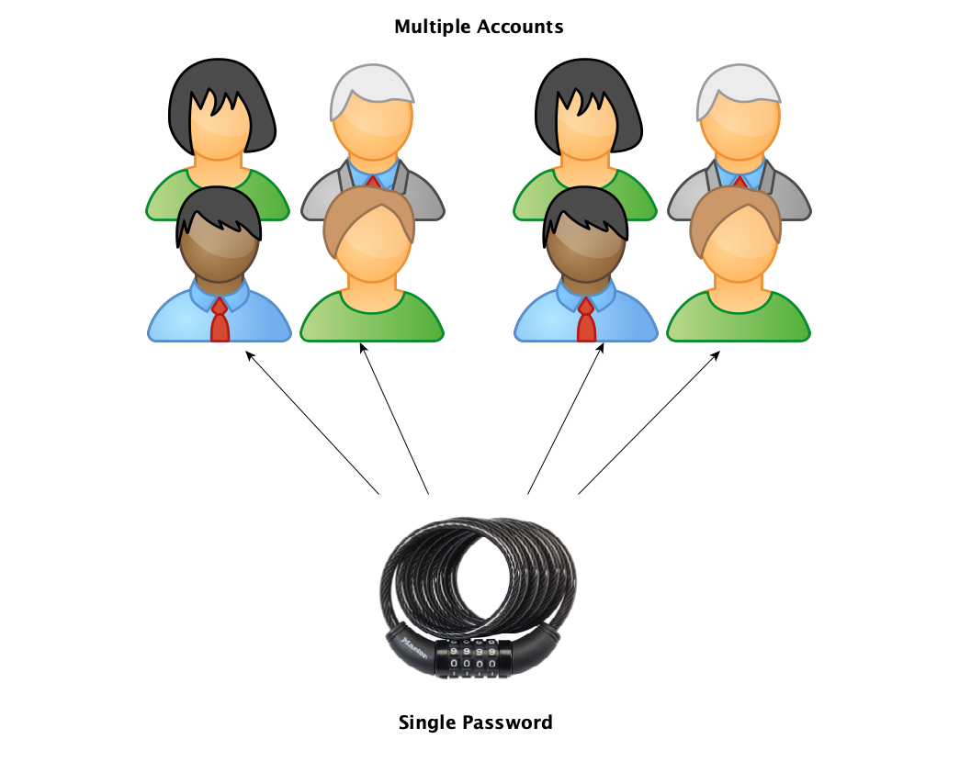
Spraying

Slide 5
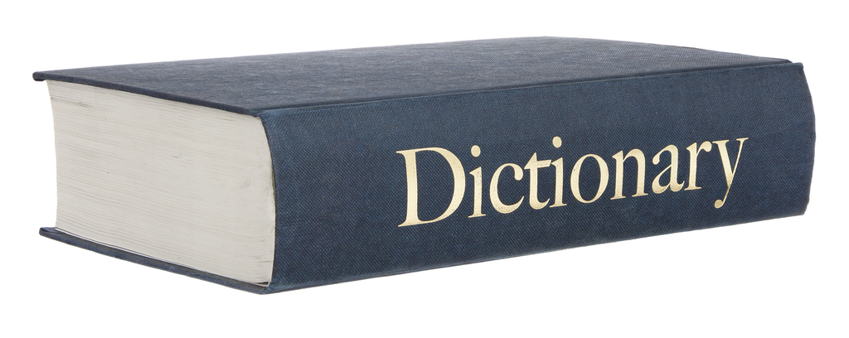
Dictionary
Brute force type attack
Uses large dictionary list
Notes:
Authority, Trust, Urgency, Familiarity, Scarcity

Slide 6

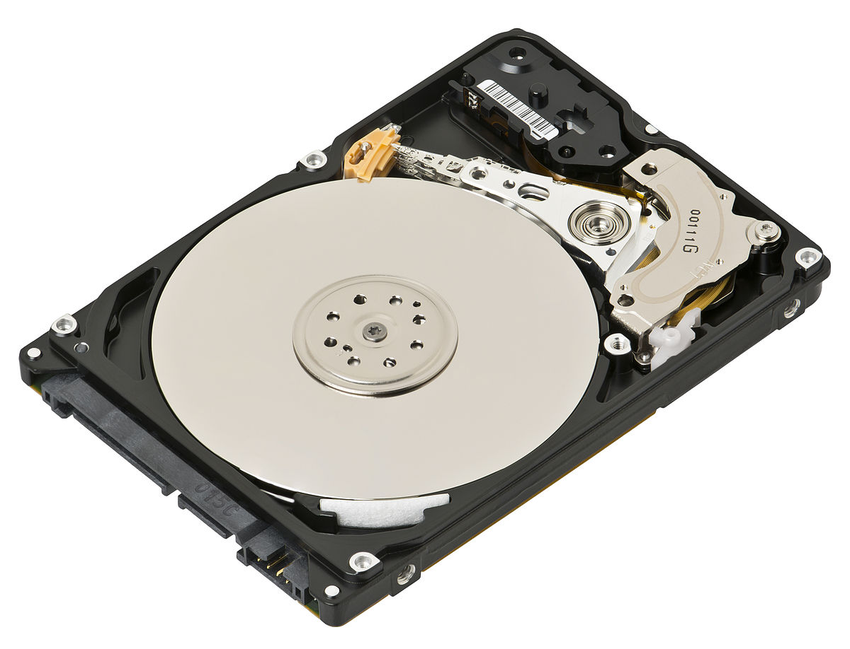
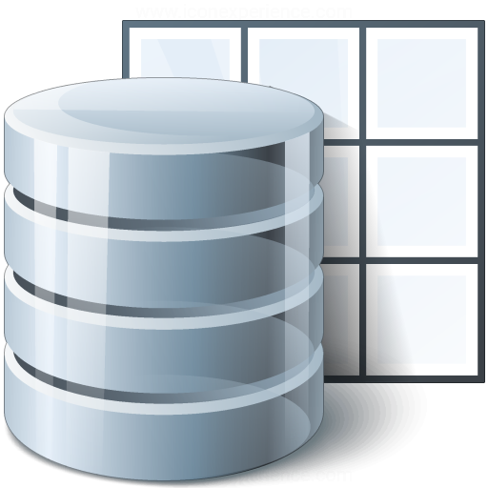
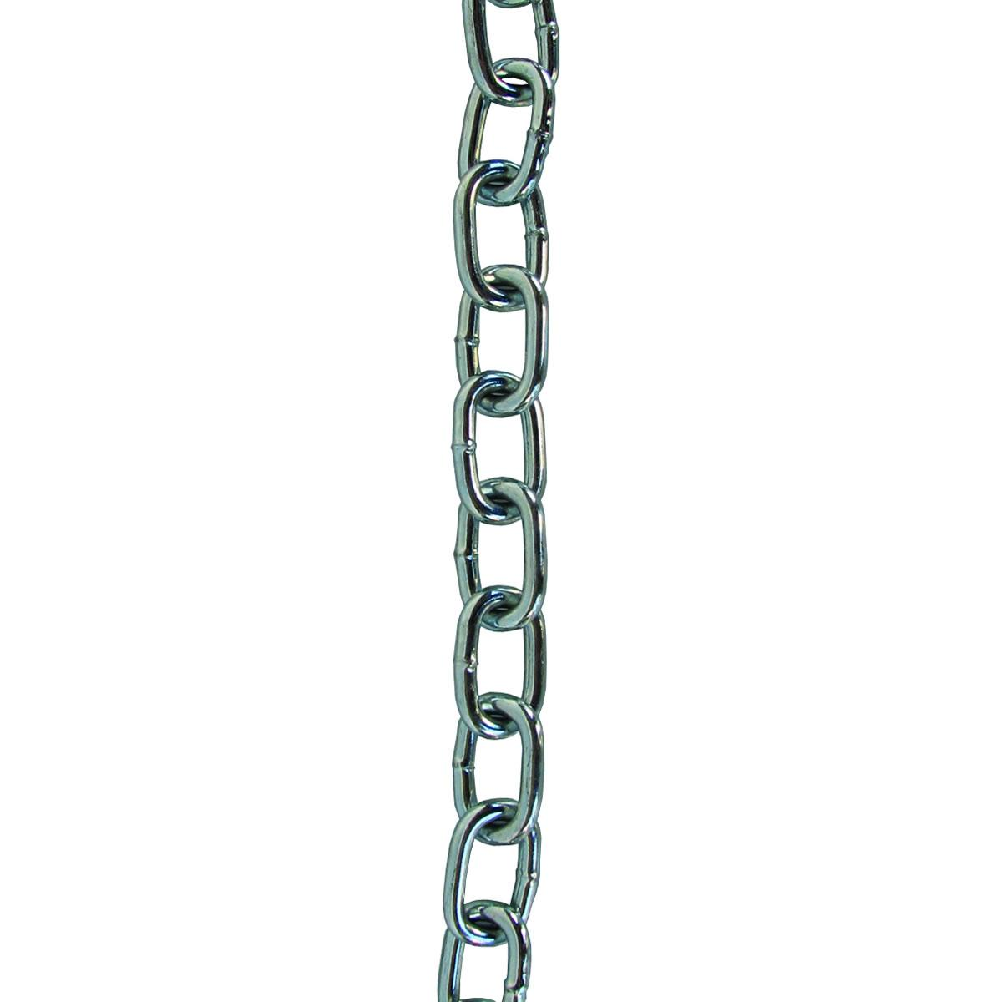
Rainbow Tables
Use precomputed chains
Chains are stored in tables
Tables can be very large files
Time reduction

